Slide 1

ML Performance for proxy
LDA-c vs Spark LDA
Apache Spot, November 28th, 2016
Prepared by: Gustavo A. Lujan

Slide 2
Straight to the point

Slide 3
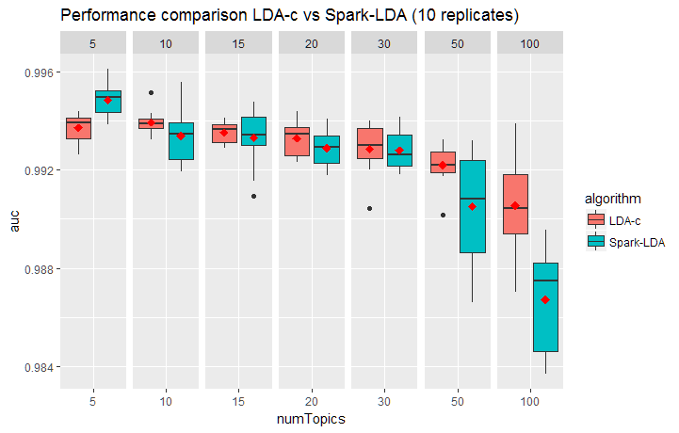
Boxplots
Performance seems to be very similar for both implementations.
Spark-LDA seems to perform better at numTopics = 5
Performance for Spark-LDA also starts to degrade as the number of topics > 50.
Spark-LDA seems to perform worse at numTopics=100.
Visual comparison is not enough. We have to prove it statistically. See next slide.

Slide 4
Two-sample t-test
We performed a two-sample t-test for mean differences for each of the numTopics.
Interestingly enough, only the extremes showed significant differences: numTopic=5 (p<0.001) and numTopic=100 (p<0.001). (See results from R at the end of the presentation)
This means that at numTopic=5 Spark-LDA performs significantly better and at numTopic=100 Spark-LDA performs significantly worse. For the rest there is no significant difference.

Slide 5
Conclusion
Spark-LDA seems to perform at least as good as LDA-c in terms of AUC.
The only significant differences were found at numTopic 5 and 100.
In terms of time, Spark-LDA took 3:30 (h:mm) to run 70 replicates and LDA-c took 7:37(h:mm) to run the same quantity. The dataset was ~9 million records.

Slide 6
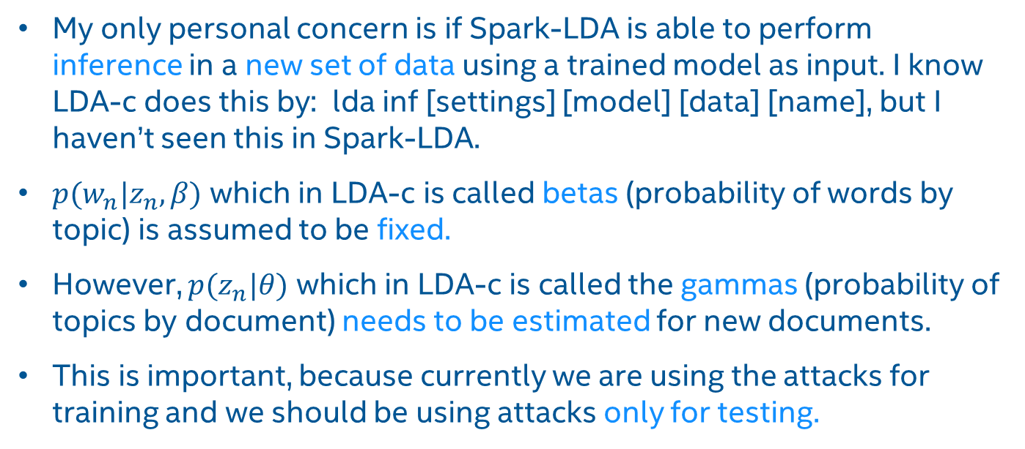
Personal concern (to be discussed with the DS team)
My only personal concern is if Spark-LDA is able to perform inference in a new set of data using a trained model as input. I know LDA-c does this by: lda inf [settings] [model] [data] [name], but I haven’t seen this in Spark-LDA.
$p(w_{n}|z_{n},β)$ which in LDA-c is called betas (probability of words by topic) is assumed to be fixed.
However, $p(z_{n}|θ)$ which in LDA-c is called the gammas (probability of topics by document) needs to be estimated for new documents.
This is important, because currently we are using the attacks for training and we should be using attacks only for testing.

Slide 7
2-sample t-test for numTopic = 5
Two Sample t-test
data: ldac$auc and spark$auc
t = -3.9925, df = 18, p-value = 0.000854
alternative hypothesis: true difference in means is not equal to 0
95 percent confidence interval:
-0.0017274542 -0.0005362462
sample estimates:
mean of x mean of y
0.9937217 0.9948535

Slide 8
2-sample t-test for numTopic = 100
Two Sample t-test
data: ldac$auc and spark$auc
t = 4.0908, df = 18, p-value = 0.0006861
alternative hypothesis: true difference in means is not equal to 0
95 percent confidence interval:
0.001872999 0.005828008
sample estimates:
mean of x mean of y
0.9905606 0.9867101

